Slide 1
Multi-Sensor Measurement Fusion
Marwan Madkour

Slide 2
Why multi-sensor?
Better accuracy
Fault tolerance
More spatial coverage
Different sensors

Slide 3
Assignment Two Extension
Modified code to allow for multiple sensors and their parameters.
Used measurement fusion.
Added functionality for different sampling time.
Keep track of the last time a measurement is taken
When measuring at the same time it results in zero delta time: F, G change

Slide 4
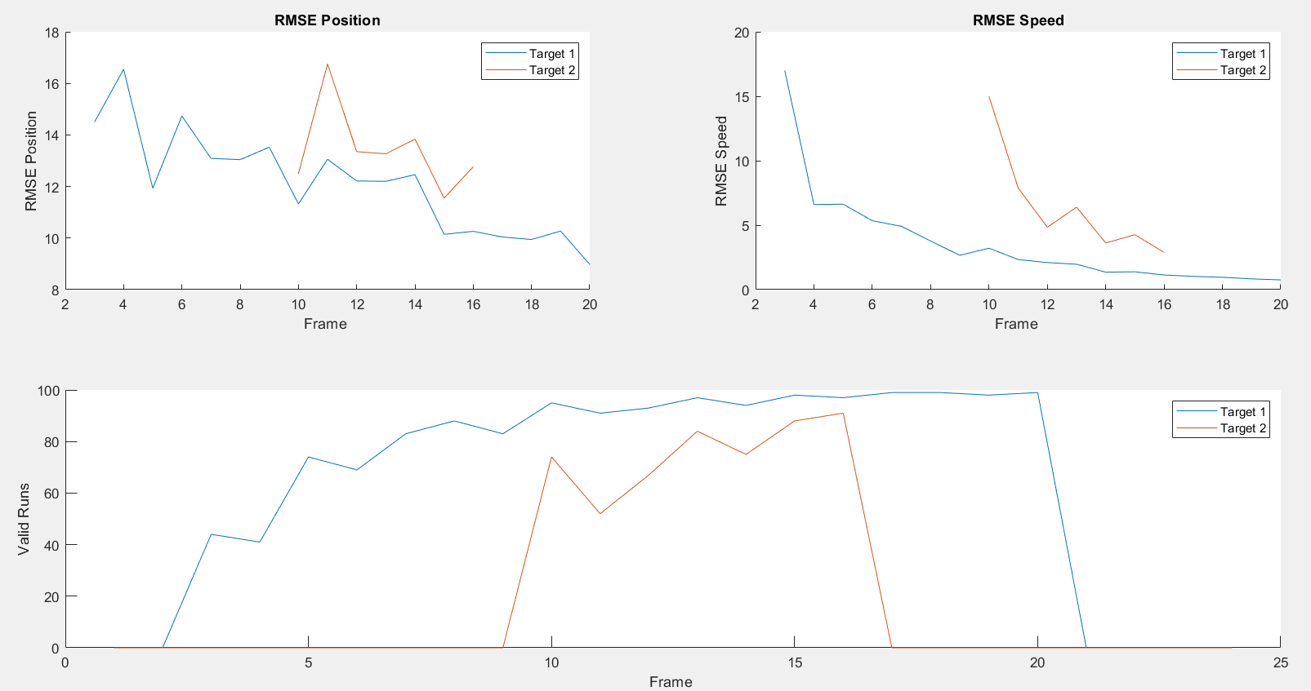
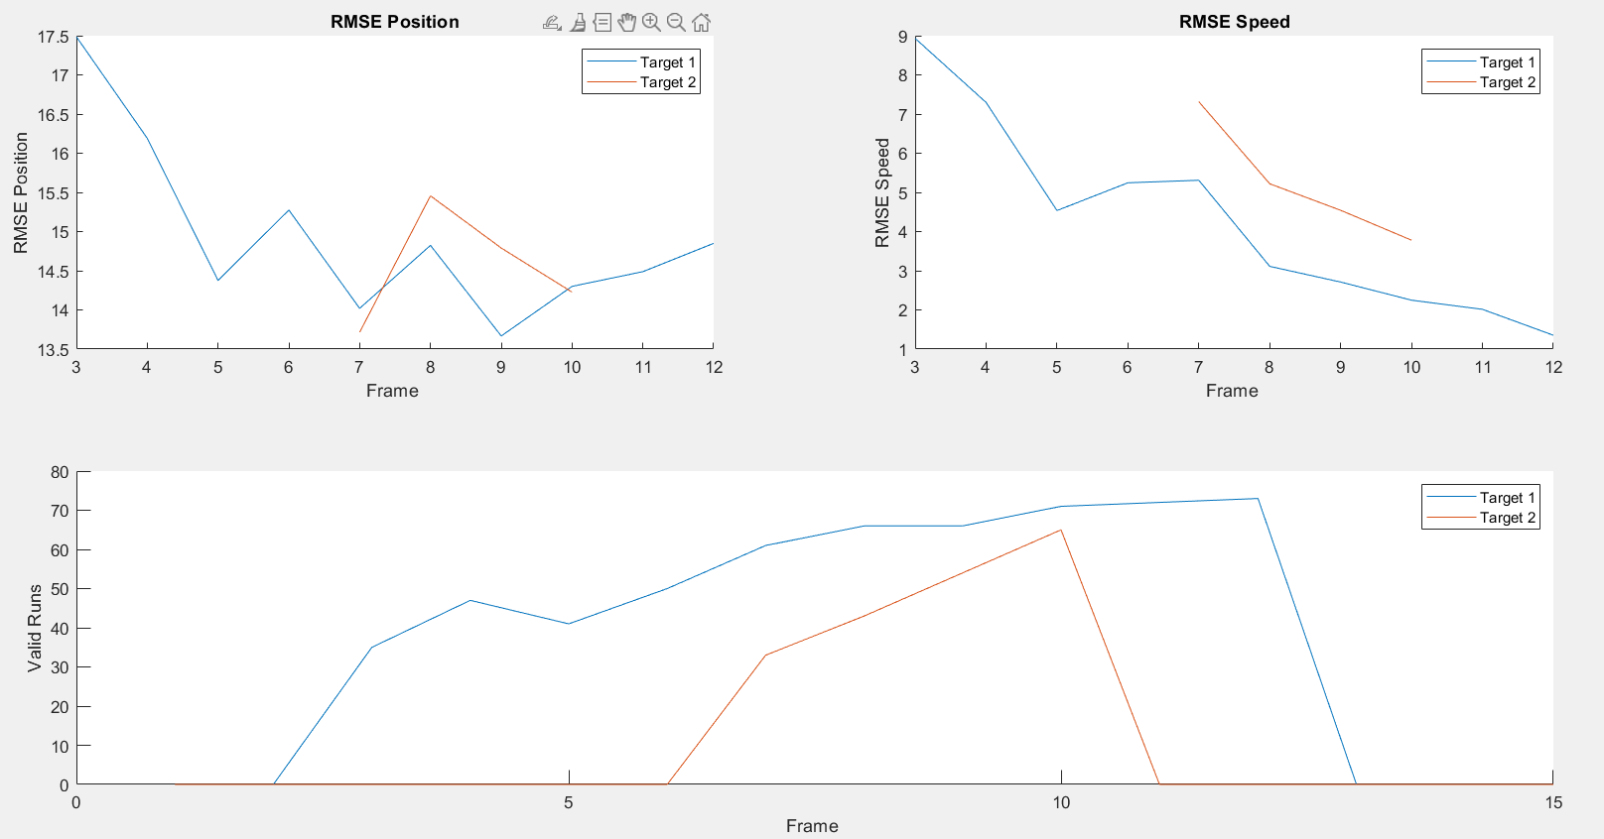
Single Sensor vs Two Sensors
Sampling times: 2 & 3
Single Sensor | Dual Sensor

Slide 5
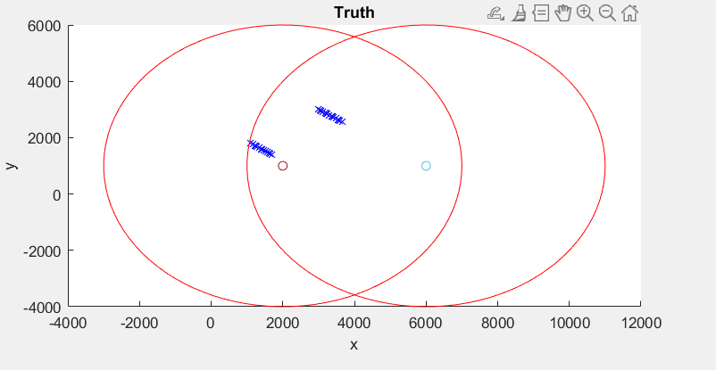
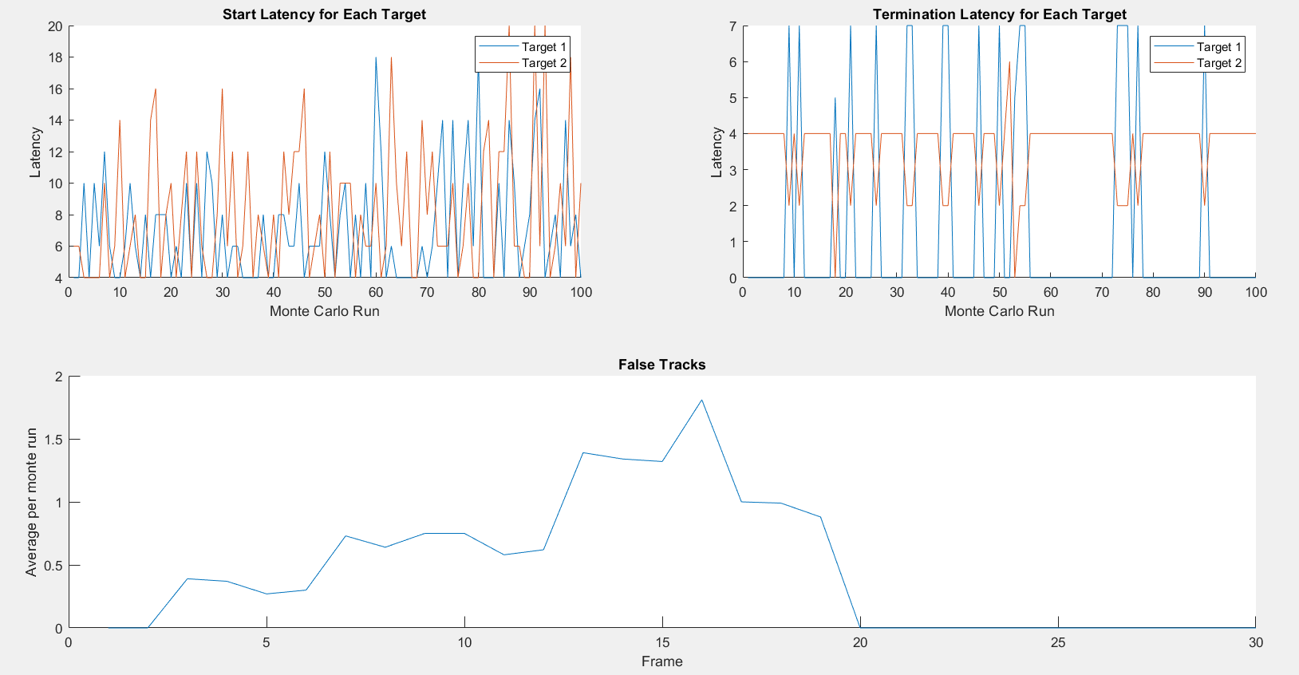
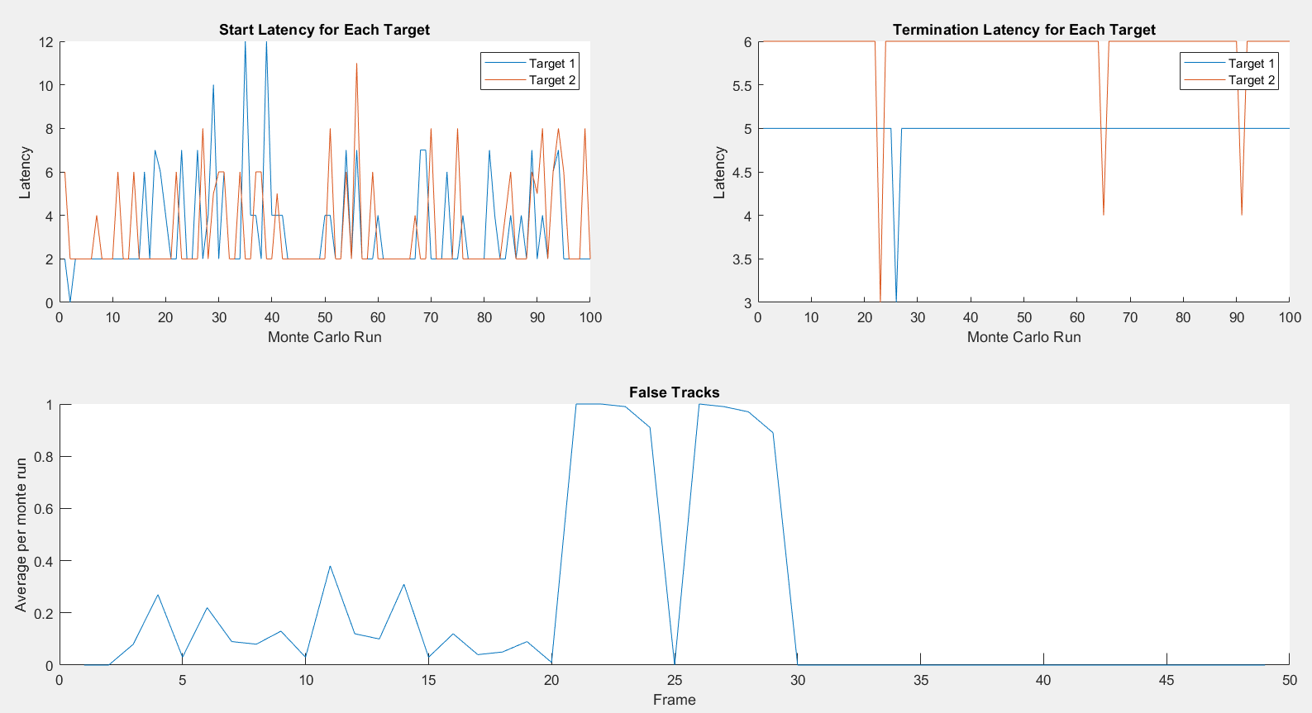
Single Sensor vs Two Sensors
Sampling times: 2 & 3
Single Sensor | Dual Sensor

Slide 6
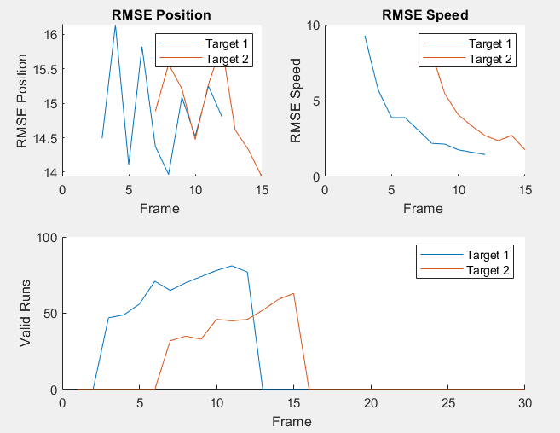
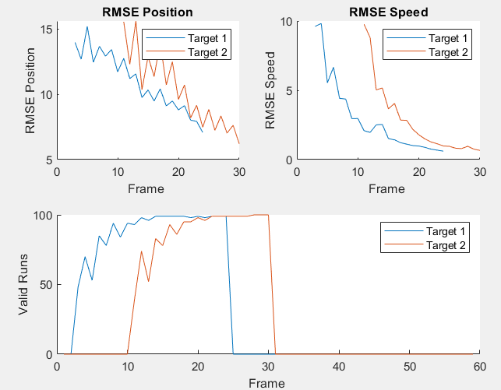
Single Sensor vs Two Sensors
Sampling time: 2 & 2
RMSE goes down more
Single Sensor | Dual Sensor

Slide 7
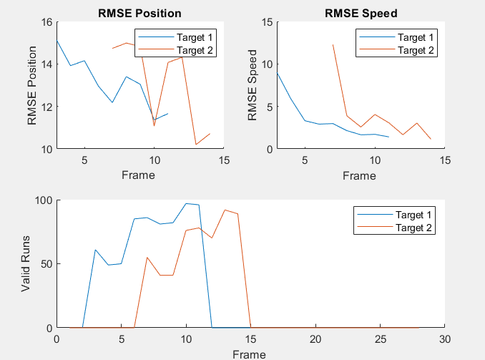
Different Sampling Times
RMSE goes down more
3 and 7 | 2 and 2

Slide 8
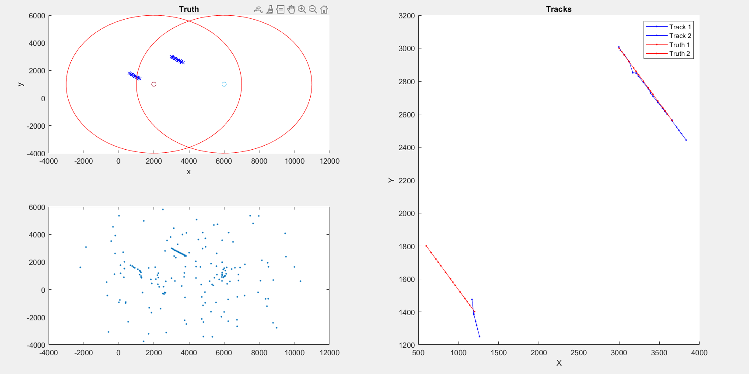
Sensor coverage
m_tent=3
n_tent=3
m_conf=5
n_conf=5

Slide 9
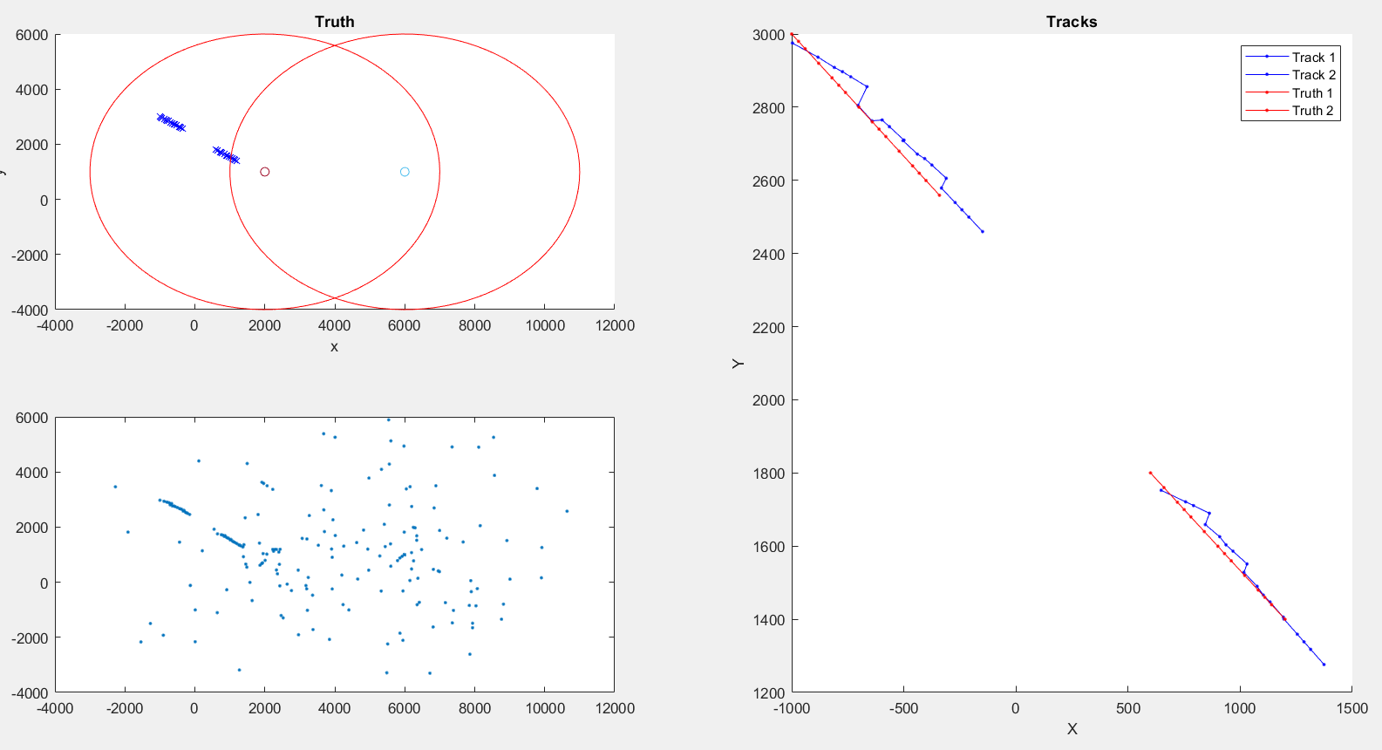
Sensor coverage
m_tent=3
n_tent=6
m_conf=5
n_conf=5

Slide 10
Conclusion
For our case, multiple sensors do not increase accuracy significantly.
More range coverage.
Better for different types of sensors with different parameters.
Latency might increase for sensors with different sampling times.

Slide 11
Thank you

